Slide 1


General hygiene (completion, grammar & language, picture)
Summary (objective, relevant experience) i.e. mini elevator pitch
Experience (with description of responsibilities)
Education & Skills (university degrees, certifications)
1
Guiding principles for developing a solid digital profile (LinkedIn example)
2
3
4
Notes:
To summarize, make sure your digital profile is clean, it includes a summary with an objective, details about your experience, and all relevant education and skills.
And remember that these four principles are applicable, in different ways, not only to Linkedin, but to many of the online professional platforms that you use. So I encourage you all, when you get to chance, to try to apply the same logic to all your digital profiles.

Slide 2
General hygiene (completion, grammar & language, picture)
1
Guiding principles for developing a solid digital profile (LinkedIn example)
Notes:
So how can you, with very limited effort, improve your digital profile. There are four simple guiding principles:

Slide 3
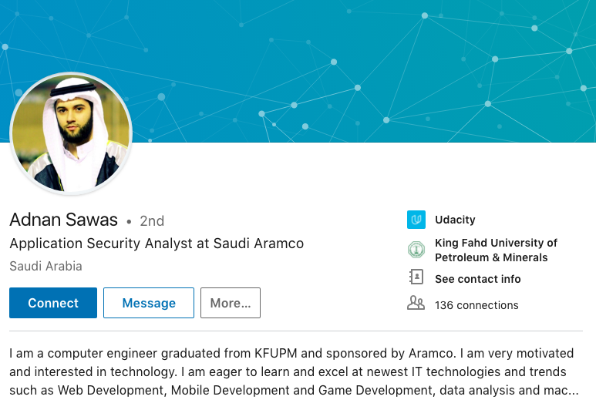
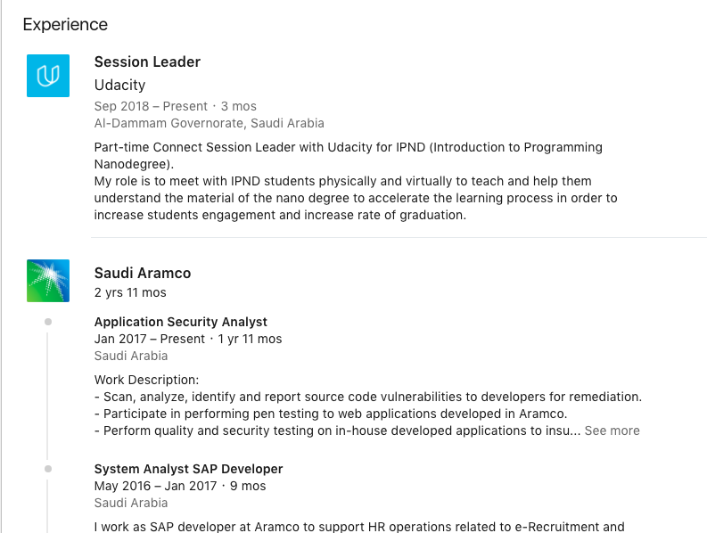
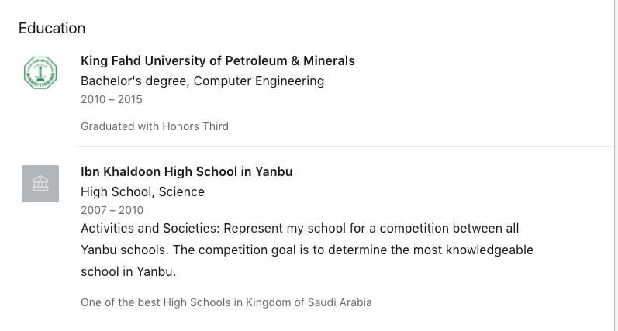
General hygiene
Picture is professional
Complete profile: includes summary, experience. education, and skills sections
Uses correct and consistent grammar
Notes:
Adnan Swas is one of our gradutes and has recently become a session lead at Udacity. His profile has strong general hygiene:
His profile is complete
His picture is professional
And his grammar use is correct and consistent
The strength of his profile allowed him to land several job interviews in fields totally unrelated to what he does currently as an application security analyst, two weeks ago as part of the MISK Udacity career fair, and he made to final round with 2 companies.

Slide 4
General hygiene (completion, grammar & language, picture)
Summary (objective, relevant experience) i.e. mini elevator pitch
1
2
Guiding principles for developing a solid digital profile (LinkedIn example)
Notes:
The second guiding principle is providing an effective summary

Slide 5
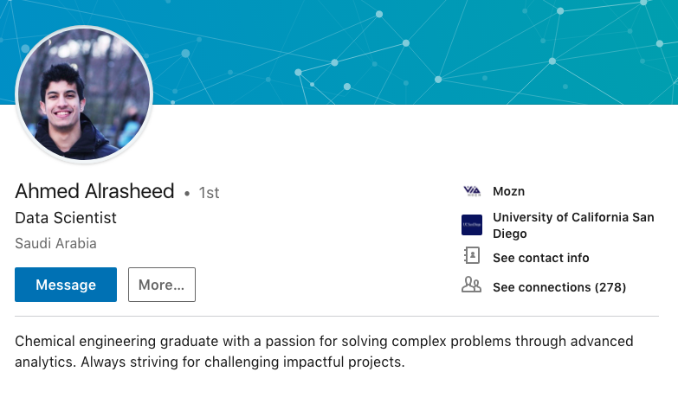
Summary
Describes background & professional goals
1-4 sentences in length
Written in first person
Notes:
Ahmed Alrasheed is a graduate from our Machine Learning nanodegree. He is a chemical engineer by background, but was interested in learning how to use data to solve complex decisions, and pivoted his career to becoming a data scientist at Mozn.

Slide 6
General hygiene (completion, grammar & language, picture)
Summary (objective, relevant experience) i.e. mini elevator pitch
Experience (with description of responsibilities)
1
Guiding principles for developing a solid digital profile (LinkedIn example)
2
3
Notes:
The third principle is providing your work experience, and not just where you work but a description of your responsibilities

Slide 7
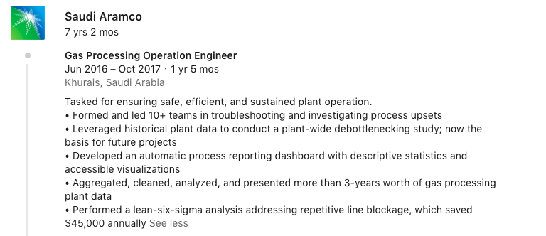
Experience
Complete role title (start date, end date, month location, company)
Bullet points: 1 sentence; 1.5 sentence long
Impact: Concrete impact of role (% change, $$)
Notes:
This is just one section of Ahmad’s work experience.

Slide 8
General hygiene (completion, grammar & language, picture)
Summary (objective, relevant experience) i.e. mini elevator pitch
Experience (with description of responsibilities)
Education & Skills (university degrees, certifications)
1
Guiding principles for developing a solid digital profile (LinkedIn example)
2
3
4
Notes:
So how can you, with very limited effort, improve your digital profile. There are four simple guiding principles:

Slide 9
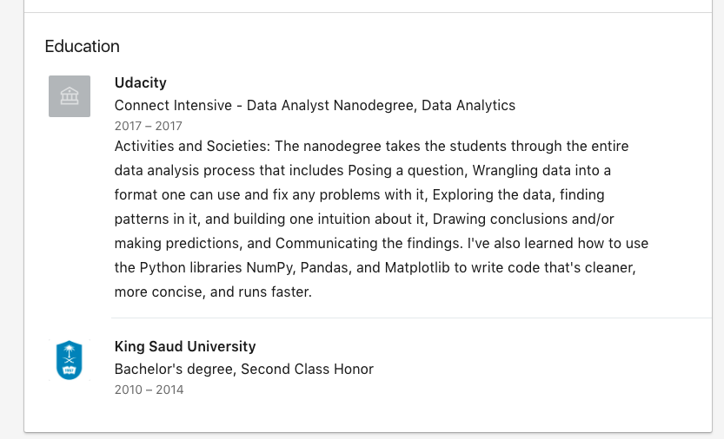
Education
Newest to oldest: Begins with most recent education experience
Certifications: Includes certifications, e.g. Udacity ND
Description: offers description for recruiters who may not know about Udacity
Notes:
This is the profile of an amazing graduate, Shaikha Al Salem, who has an bacgkround in Art

Slide 10
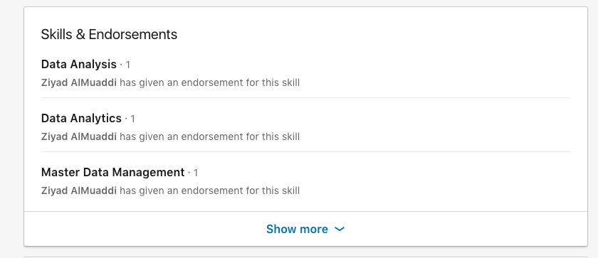
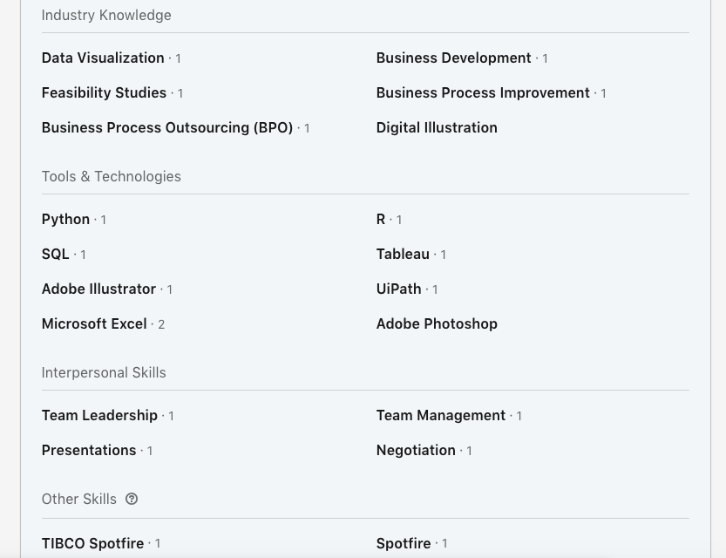
Skills
Skills are ‘technical’; doesn’t include ‘show, not tell’ leadership skills, e.g. attention to detail
Offers deep-dive of all skills at click of ‘show more’
Notes:
Company/organization, title of role, start and end date (month & year), location

